Slide 1
Pneumonia (Definitely Not Lung Cancer) Detection
By Alex Hyman & Kristin Cheung
MDGRPHCS / SHUTTERSTOCK.COM
Notes:
Hello, my name is Alex Hyman, and my partner is Kristin Cheung and the topic for our final project was pneumonia detection, which is definitely not the same as lung cancer...

Slide 2
Why Pneumonia?
Pneumonia accounts for over 15% of all deaths of children under 5 years old internationally^{[1]}
In 2015, 920,000 children under the age of 5 died from the disease
In the United States, pneumonia accounts for over 500,000 visits to emergency departments and over 48,000 deaths in 2016^{[2]}
While the disease is common across the world, it is notoriously difficult to diagnose
For a pneumonia to be accurately diagnosed^{[3]}:
A chest radiograph needs to be reviewed by a highly trained physician
Confirmation needs to be conducted through clinical history, vital signs, and laboratory exams
Notes:
There were two main reasons why we chose to work on this topic. The first reason was that we wanted a technically challenging problem where we could learn some new skills and theories.
The second reason we chose this topic was because pneumonia is such a widespread problem. Pneumonia is a disease that can effect anyone, but it is a common cause of death for children under five years old, or adults over 65. In 2015, pneumonia accounted for 16% of all deaths worldwide of children under 5 years old; pneumonia also killed over 48,000 Americans in 2016 alone.
Additionally, Pneumonia is a disease that is notoriously time consuming and difficult to diagnose. Generally, a diagnosis of pneumonia requires a chest radiograph and laboratory exams.

Slide 3
What are we doing, and why?
Given a chest radiograph:
Can the presence of pneumonia be determined?
Classification
Can we find the areas affected by pneumonia?
Localization
Why would this be helpful?
It is much easier to have a chest radiograph taken than a diagnosis made
Having a machine learning model evaluate a chest radiograph can prioritize patients for doctors inspections
Presence of pneumonia
Area of affected lung
Notes:
To help alleviate the time consuming nature of diagnosing pneumonia, we are going to try to apply machine learning techniques on chest x-rays to determine, First, whether a patient has pneumonia, and then secondly the specific areas within a patients lungs that the pneumonia is effecting.
The reason we decided to convert this into a two-pronged approach is because a pneumonia diagnosis will likely require a physician review no matter what, but we would like to come up with two different models that would allow doctors to prioritize the order in which patients radiographs will be reviewed by physicians. If a patient is predicted to have to have pneumonia, the doctor would likely prioritize reviewing that radiograph compared to a patient that has not been predicted to not have pneumonia. The doctor could then prioritize the patients within the group predicted to have pneumonia by using a combination of age and total area affected by “lung opacities” to to review high-risk patients first.

Slide 4
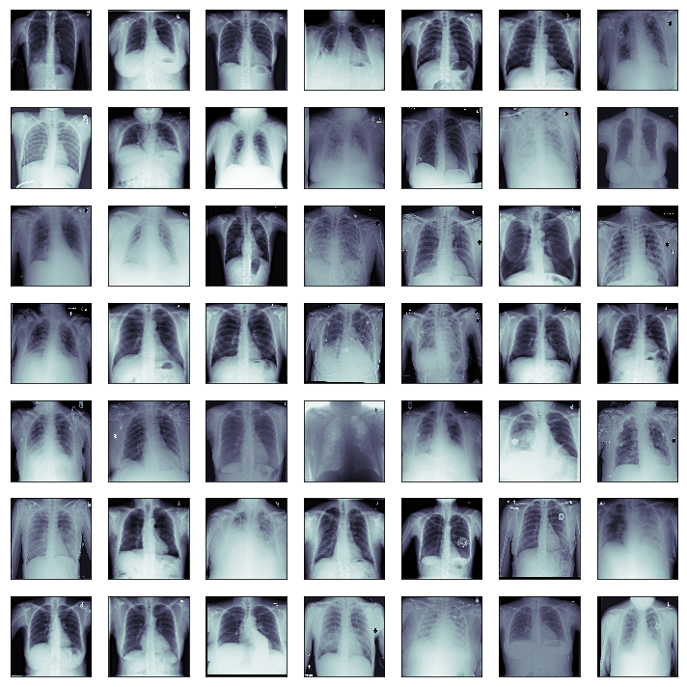
What are we working with?
Data is derived from a subset of the National Institute of Heath’s (NIH) Chest X-Ray 14 dataset (CXR14)
Unique patient data for 26,684 different anonymous patients
Two different file formats were provided:
Digital Imaging and Communications in Medicine Files (DICOM)
Comma Separated Files (CSV)
Notes:
The dataset we were working with was provided by Kaggle, but derived from the National institute of health’s chest x-ray dataset. The dataset is a combination of Digital imaging and communications in medicine files, or DICOM files, and CSV files. The total dataset included over twenty six thousand unique chest x-rays from anonymous patients.

Slide 5
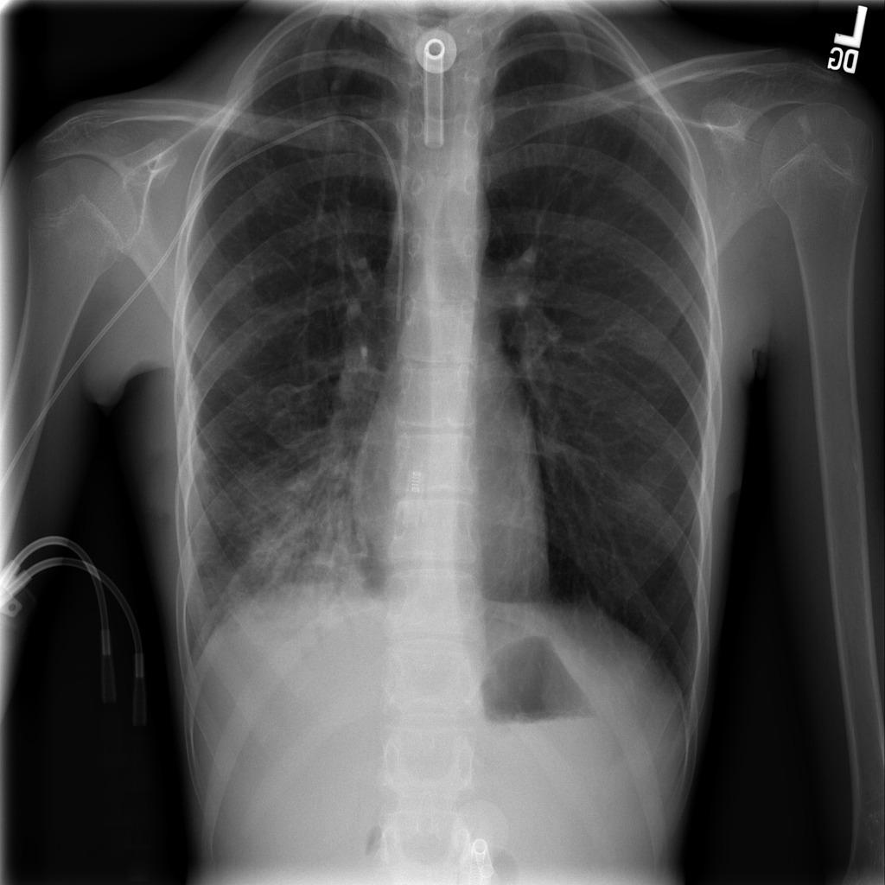
What do the DICom Files Contain?
The dataset contained 26,684 different DICOM files
One file for each of the patients
File names corresponded with the unique Patient ID
Each DICOM file contains:
X-ray of the patient (1024x1024 pixels, one channel)
Patient ID
Patient’s sex
Patient’s age
Size of the x-ray
Notes:
Each patient in the dataset was given a unique patient Id, and a DICOM file which shared a name with the patient ID. The dicom files themselves consisted of the patient’s x-ray, which was 1024 pixels by 1024 pixels, as well as the patient's Sex, and Age. the displayed image provided on the slide is an example of what a patient’s x-ray looks like. One note about the chest x-rays is that all x-rays were provided in a one-channel greyscale array.

Slide 6
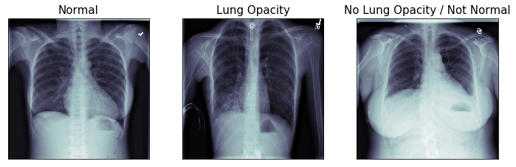
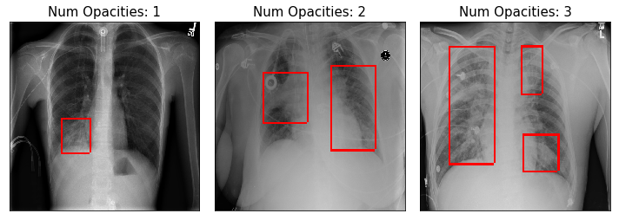
What do the CSV Files contain?
First CSV:
Patient ID
Classification of the x-ray
Normal, Lung Opacity, No Lung Opacity / Not Normal
Second CSV:
Patient ID
Target
Is lung opacity present?
Location of the lung opacity (if present)
X, Y, Width, Height on the image
Notes:
The dataset also contained two csv files. One CSV file contained each of the patient’s IDs, and how the x-ray was classified. The classes were limited to “Normal”, “Lung Opacity”, and “Not Normal”. The second CSV file contained the patient IDs for all of the patient’s with pneumonia, and the coordinates of the lung opacities as annotated by an ensemble of doctors. The top row of images on the slide provides an example of each classification. The second row of images is meant to show how the lung opacity coordinates are provided. The X and Y values given correspond to the top-left corner of the opacity, and the height and width dimensions given provide the remaining information to draw a bounding box around the lung opacity.
I would also like to point out that the color of the images on top are different from the color of the images on the bottom. This is because the raw x-rays are provided in one channel greyscale, and to better show the bounding boxes, I stacked the greyscale image array three times to create the rgb channel in order to show the bounding boxes in red.

Slide 7
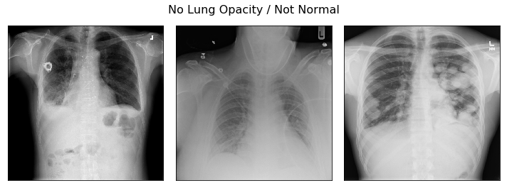
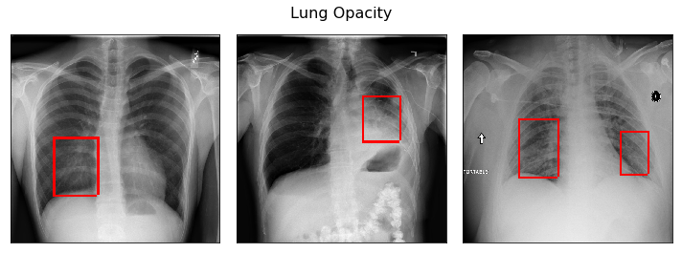
What are the Differences Between Classes?
Normal
The patient’s lung x-ray appears to be healthy and normal
Lung opacity
Lung opacities are present, the patient has pneumonia
“Opacity refers to any area that preferentially attenuates the x-ray beam and therefore appears more opaque than the surrounding area”^{[4]}
No Lung Opacity / Not Normal
Pneumonia is not present, something is off with the x-ray
Many different things could be wrong with the x-ray
Notes:
One of the more difficult challenges relating to this task was understanding what the differences between the three classes. The normal class was the easiest classification to understand. X-Rays that were classified as “Normal” were X-Rays that appeared to contain healthy lungs, no signs of pneumonia, and the X-Rays of decent quality.
The ” Lung Opacity” classification meant that the x-ray showed signs of pneumonia, due to the presence of lung opacities. The term lung opacity I found to be kind of ambiguous, and to me seemed like it could be seen differently by different doctors.
In medical terms an opacity, refers to any area that preferentially attenuates the x-ray beam and therefore appears more opaque than the surrounding area. This translated, this means: areas in the x-ray that look cloudy that shouldn’t look cloudy. This class also meant that the patient has pneumonia.
The final class for an x-ray was the No Lung Opacity / Not Normal. This was a very ambiguous class that pretty much meant that something isn’t right, but with the current x-ray, a lung opacity could not be found. Some deeper research into the dataset showed that reasons for this classification ranged from the patient having an enlarged heart, to a patient has tumors in their lungs.
The images to the right of the screen attempt to show the differences between the lung opacity classification, and the no lung opacity / not normal classification. While I am not a doctor, I will try to explain why some of the classifications on the top are not normal. the first image has a patient that has a right lung, which actually appears on the left side of the image, that is shorter than the left lung. This indicates that the patient had surgery at some point, and something else could be wrong. The second image has less of the left lung showing, which could indicate that the patient has an enlarged heart. The third image has some well-defined round blockages in the lungs, which indicates that the patient unfortunately has some kind of tumors in their lungs.
The bottom row of images shows some x-rays within the lung opacity group, along with a red bounded box laid on top of where the doctors said that an actual lung opacity is present.

Slide 8
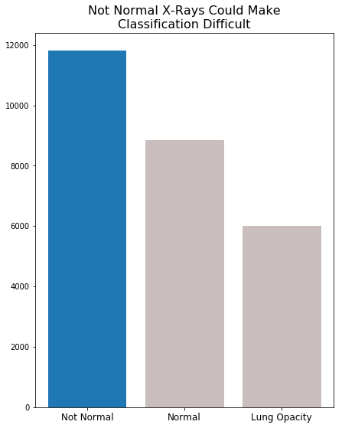
What considerations should be made for Classification?
Should “Not Normal” x-rays be consolidated with “Normal” x-rays?
No, if a patient does not have a normal x-ray, they could still have some serious condition
If the x-ray is low quality (and not normal) a patient could still have pneumonia
Do we we need to balance the training and test sets?
Yes, training and test sets should have equal amounts of each classification
66-33% train-test split was utilized
Notes:
One change to the dataset we thought about making was combining the Not Normal class with the Normal class. While idea doesn’t make much sense out loud, the thought process was that lung opacities would only be detected in an image if the image was within the lung opacity class. Combining the Normal and Not Normal classes would convert this problem into a binary Target vs. Non-Target classification problem. However, given the potentially catastrophic diagnosis Not Normal images could still contain, we decided it was best to keep this a three class classification problem.
We also wanted to look at the distribution of classes within the dataset to see whether we need to balance the classes when we split our training and test set. What surprised us when we looked at the distributions was that there were more “Not Normal” images than any other class. We expected normal to be the most frequently occurring class, partially due to the name being Normal, but given the difficulty of taking a quality x-ray image, we could see how not normal could occur more frequently. However due to the unbalanced distribution of the classes, we decided that the training and test sets needed to have the same count of each class throughout the two sets.

Slide 9
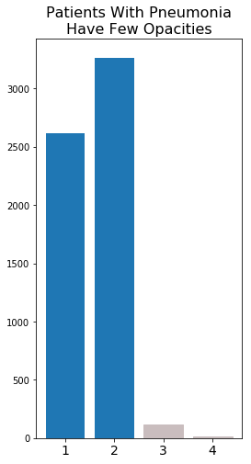
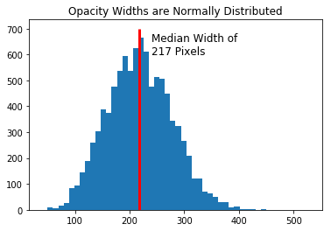
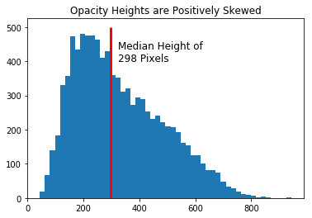
What considerations should be made for Localization?
Should we limit the number of bounded boxes predicted?
Yes, few patients have more than two lung opacities
What shape are the opacities?
Median box more tall than wide
Median opacity has area of about 6.2% of the entire image
Notes:
More specific to the task of localizing the lung opacities, we wanted to get an idea of the count of lung opacities in patients with pneumonia, and the consistency or shape of the lung opacities.
The counts of the number of patients with lung opacities showed that generally, patients have either one or two lung opacities, and very rarely more than three. This information allowed us to feel comfortable in limiting the number of bounded boxes an object detector could make on an image.
We also looked at the distribution of heights and widths of the different lung opacities. These distributions showed us that there is a large range in the shapes of the lung opacities; however the opacities have a more normally width when compared to the positively skewed height. We had also determined that the median area of a lung opacity takes up a little more than 6% of the total area of the image, which seemed really small to us. However, because of the limited are that a lung opacity could occur, the object detector should become relatively good at proposing areas to look for lung opacities.

Slide 10
How Did we classify X-rays?
Created a MongoDB to store patient information including path to file, patient class, and opacity coordinates (if applicable)
Randomly selected 6,000 images for each of the “Normal”, “No Lung Opacity / Not Normal”, and “Lung Opacity” classes
Randomly selected 4,000 images from each class to be in the training set, and the remaining 2,000 images to be in the test set and shuffled the order of images
Trained Neural Networks on the training set to classify via:
Convolutional Neural Network (CNN) from scratch in TensorFlow
Transfer learning from pre-trained models provided by Keras
Evaluated model on test set
Notes:
After we felt relatively comfortable with the data at hand, we began the process of training a classifier. Some of the steps we took in order to build the classifier included building a Mongo Database for data management, creating a training set of 12,000 images and a testing set of 6,000 images, each of which had uniform counts of each class, training the neural network on the training images, and then evaluating the neural network on the test images.
We decided to try two different approaches when building the classifier. The first approach was to build a Convolutional Neural Network from scratch in TensorFlow. The second approach was to utilize transfer learning from the pre-trained models provided in keras to classify the chest x-rays.

Slide 11
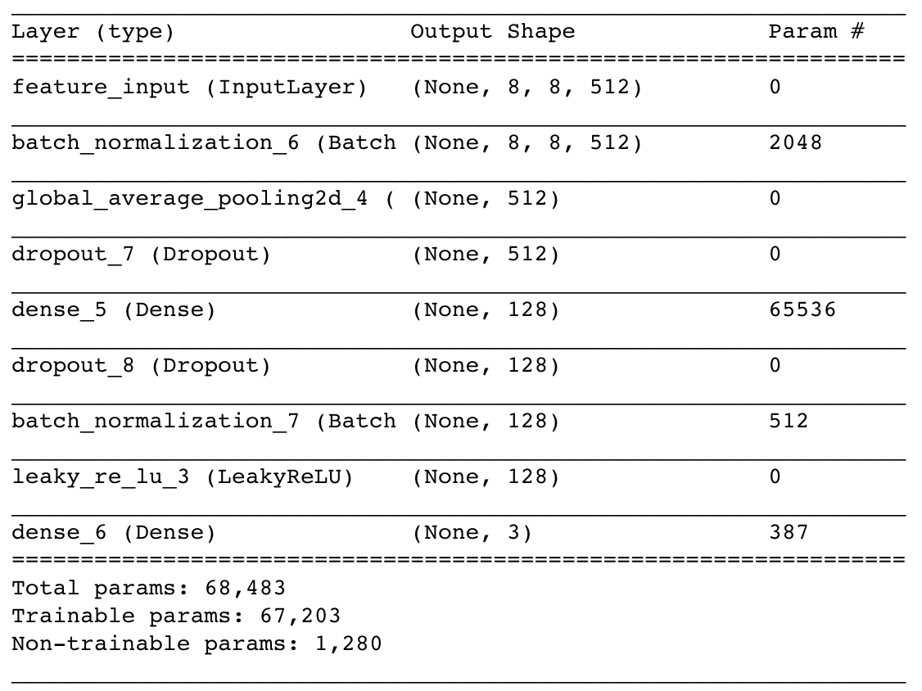
What is Transfer Learning?
Using machine learning models previously trained for a source task, and changing the purpose of the model to address a target task
Source task: ImageNet
1,000 different classes
Pre-trained convolutional layers were frozen, and new fully connected layer was created
Models Used:
VGG-16
VGG-19
DenseNet
Fully-connected layer for VGG-16 Model
Notes:
The idea behind transfer learning is to use weights that were trained for a similar task, and then re-training them to model a slightly different task, which in this case was classifying pneumonia. The three models we looked at for transfer learning were the VGG-16, VGG-19, and the DenseNet models. These convolutional model would have their convolutional layers frozen, and a new fully-connected layer would be trained for the task of classifying the chest x-rays. The weights we used to train the models were originally learned from the imagenet competition, in which 1,000 different classes were classified. To the right of the slide we provided the fully-connected layer that were used for the VGG-16 Model. If you look closely we used used some different regularization techniques to try to speed up the training process.

Slide 12
Training the Classifier
Before large scale training, a small subset of images would be overfit to the model
Check to make sure the model would converge in timely fashion
TensorFlow model from scratch did not converge in 1,000 steps
VGG-16, VGG-19, and DenseNet converged in less than 25 steps
The image was resized to be 256x256x3 for each of the transfer learning models
Original greyscale image was stacked three times to produce three channels
Training was then conducted for the VGG-16, VGG-19, DenseNet models
Model | Batch Size | Steps | Training Time
VGG-16 | 24 | 10,000 | ~ 14.5 hours
VGG-19 | 24 | 10,000 | ~ 20 hours
DenseNet* | 24 | 7,500 | ~ 12.5 hours
* DenseNet trained for fewer steps due to time constraints
Notes:
Now back to trainging. Before we began training the classifier on all the training images, we selected a small subset of images in the training set and attempted to overfit a sample model. This process of overfitting a model to predict on this small subset of data would show us that the neural network had the potential to converge, hopefully in a timely manner. Using this process showed us that the tensorflow model we developed from scratch could not converge on the subset of six images in 1000 steps, this was compared to the transfer learning models, which all converged on the small subset in under 25 steps. Therefore we decided to scrap the tensorflow model we created from scratch.
After we determined that the transfer learning models would perform best, we began training. One important pre-processing edit we made to the images was that we scaled down the images to 256x256 to save time in training, and we stacked the image array for each image on itself three times because the pre-trained models were designed for images with three channels. Each of the models took a batch size of 24 images, and the two VGG models were trained for 10,000 steps. Due to the limited compute available to use and the project due date staring us in the face we were only able to train the DenseNet Model for 7,500 steps. The DenseNet model took the least amount of time to train of 12.5 hours, but this is due to the fewer steps we allowed the model to train for. The VGG-16 model trained for 14.5 hours and the VGG-19 model trained for 20 hours.

Slide 13
Evaluating the classifier
VGG Models Performed Better than DenseNet
Prioritizing recall for “Lung Opacity” class and precision for “Normal” class
If “Lung Opacity” were to be misclassified, preference to class “Not Normal / No Lung Opacity”
DenseNet had worst “Lung Opacity” recall and “Normal” precision
Little difference in performance metrics between VGG-16 and VGG-19
Slight performance edge to the VGG-16 model
Model | Prediction Time* (mm:ss) | Overall Accuracy | Lung Opacity Recall | Normal Precision
VGG-16 | 24:38 | 0.650 | 0.74 | 0.70
VGG-19 | 29:28 | 0.643 | 0.73 | 0.71
DenseNet | 28:55 | 0.519 | 0.45 | 0.48
*Prediction time on the test set of 6,000 images
Models Had Difficulty Correctly Classifying
Not Normal Class (VGG-16 Confusion Matrix)
 |  | Predicted
 |  | Not Normal | Lung Opacity | Normal
Actual | Not Normal | 735 | 723 | 542
 | Lung Opacity | 336 | 1472 | 192
 | Normal | 242 | 64 | 1694
Notes:
After the training was complete, we used each of the models to predict the class of the images in the test set. To evaluate the performance of the models, we decided to look at four different metrics: prediction time, overall accuracy, lung opacity class recall, and Normal class precision. We decided prediction time was an important metric when evaluating the performance of the model because a timely prediction would be preferred to a delayed prediction. Overall accuracy was a chosen metric because we decided it is an easy indicator of how well the model performs overall, but the two metrics we prioritized most were lung opacity class recall and normal class precision. We chose these two metrics because of the risk associated with using machine learning to help diagnose patients. Lung opacity recall was important because we want to be able to trust that the model we choose is catching the highest percentage of lung opacity images within the lung opacity class. And we chose the precision of the normal class as an important metric in the evaluation phase because we want to have as clean of a “Normal” class as possible, especially if those patients are given lower priority.
Looking at the model metrics to the right, we found that the VGG-16 model, had the fastest predicting time, and the highest overall accuracy, and lung opacity recall of the three models tested. The VGG-19 model had the highest Normal precision of the models tested, and performed fairly similarly to the VGG-16, however due to the faster prediction time of the VGG-16 model, we determined that the VGG-16 model was the highest performing classifier that we had trained. The DenseNet model did not perform nearly as well as the VGG models, but due to the shortened training time, there is a chance that the DenseNet model could perform as well as the VGG models.
Below the model metrics, we provided a confusion matrix of the VGG-16 model. As you can see, the most frequently occurring misclassification was classifying Not Normal images as Lung opacities. This is understandable due to the ambiguity within the not normal class. However, only about 10% of the lung opacity images were misclassified as Normal images, which is a relatively low misclassification rate compared to the other misclassifcations.

Slide 14
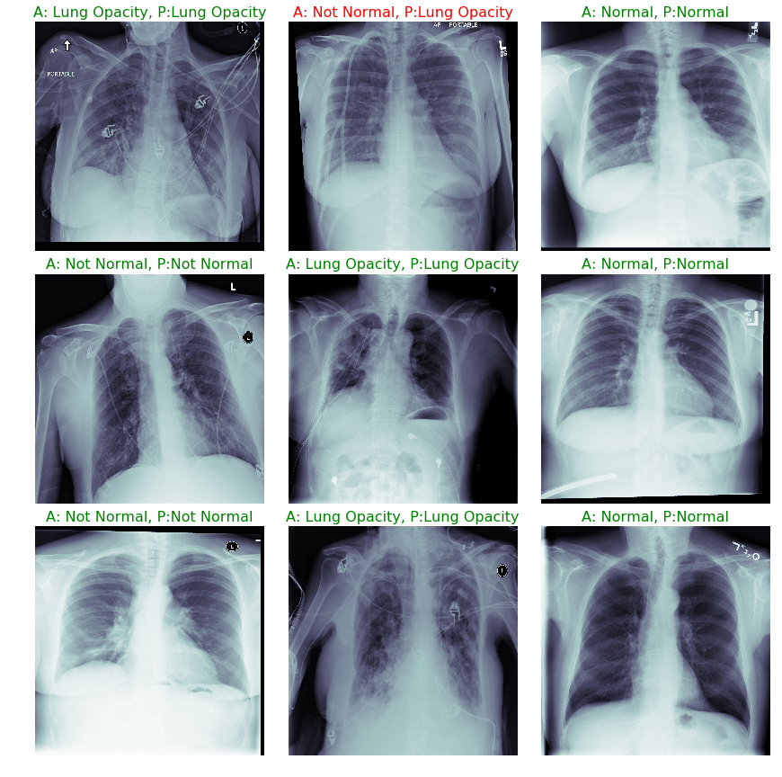
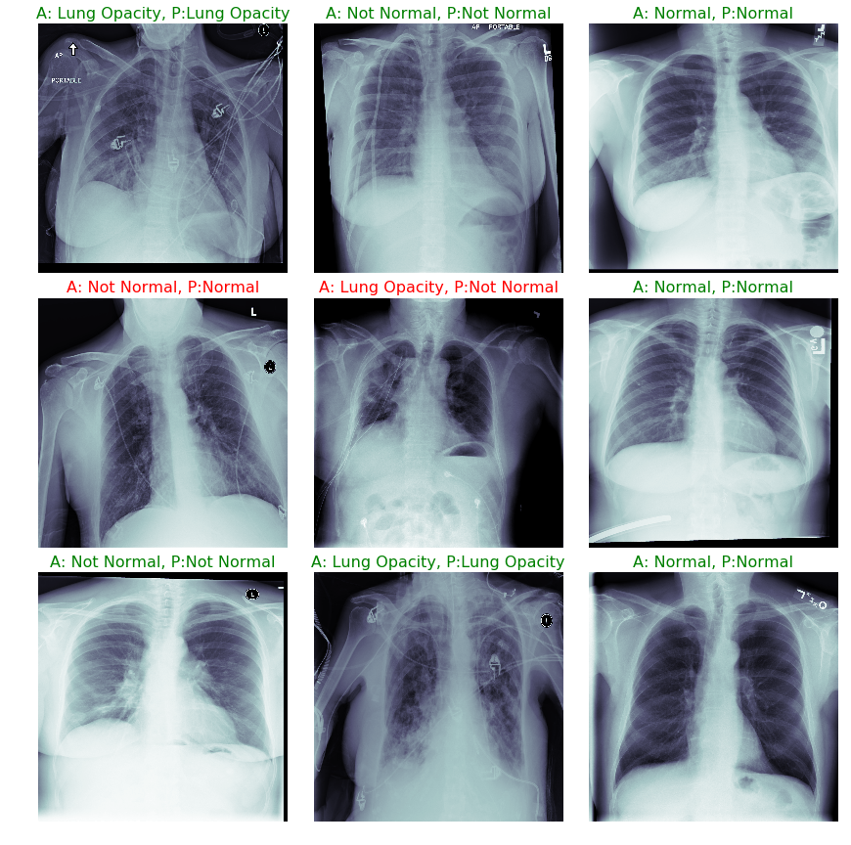
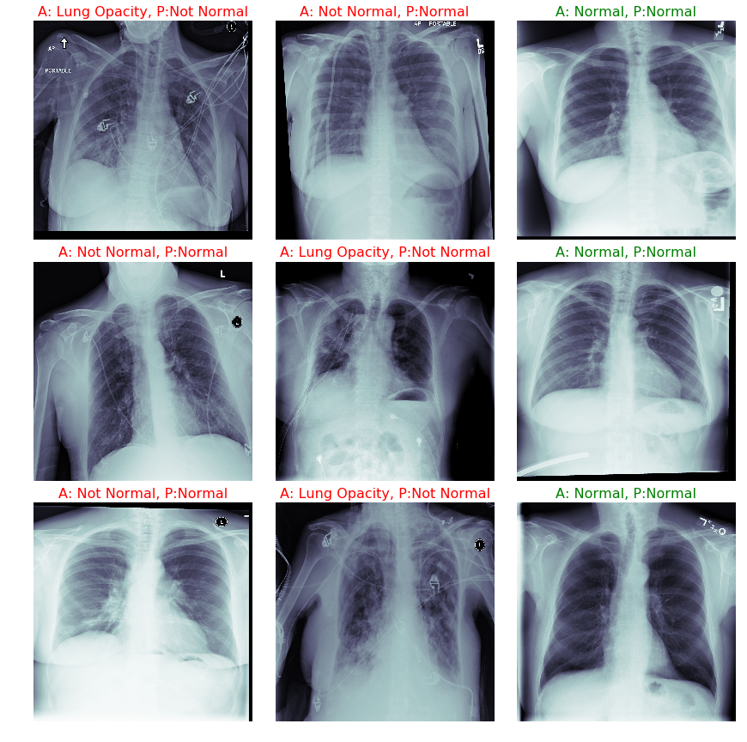
Demonstration of X-Ray Classification
VGG-16
VGG-19
DenseNet
Notes:
To get an idea of the performance of the classifier, we took a look at the first 9 images in the test set and looked at the prediction each classifier had made for each of the images. One trend that was immediately apparent was the difficulty the classifier had in understanding what the “Not Normal” class meant. Every misclassified image show was either predicted as a Not Normal image, or was actually a not normal image predicted as another class. The misclassified images have the labels shown in red, and the correctly classified images have their labels shown in green. Once again, the VGG-16 model outperformed the other three models in terms of accuracy, notwithstanding the small sample size.

Slide 15
How did we Detect the Opacities?
Created a JPEG image of each x-ray with lung opacities
For each of the lung opacity images, created an XML file that stated the file path and the bounding box dimensions
Separated the images into an 80-20% train-test split
Creates a CSV that contained the information in the XML file
Created TensorFlow train and test record file for the TensorFlow Object Detection API
Downloaded model (architecture) to train from the TensorFlow GitHub
Single Shot Detection (SSD) MobileNet Version 1 – Primarily used for mobile devices, faster to train and predict
Faster RCNN (Resnet101) – Generally performs better than SSD, but takes more compute time
Trained the object detection model
Evaluated the model on the test set
Notes:
After we trained our classifier to determine which images contain are normal, not normal, or contain lung opacities, we began working on our opacity detector. The tool we found to best detect lung opacities was the TensorFlow object detection API.
To use the tensorflow object detection API, we first converted all of the x-rays that had dimensions for lung opacities into jpeg images and created a corresponding xml file stated the locations of lung opacities. Then we placed 80% of the jpegs and xmls in a training folder, and 20% of the jpegs and xml files into a test folder, and created two tensorflow dot record files that contained metadata for all of the images in the training set, and all of the images in the test set. Then, on the TensorFlow github page, we downloaded the two models that we wanted to train and a sample configuration file for the models.
The two models we chose to train for object detection were the Single Shot Detection or (SSD) Mobile Net model, and the Faster RCNN ResNet101 model. The SSD model was built by google, and intended to be used in mobile devices. This attribute results in quicker training and predicting time, however the SSD mobilenet model is generally less accurate than some of the larger, more computationally intensive models. The Faster RCNN model is one such model. Characteristics of the Faster RCNN model include slow training time, slow predicting time, and smaller batch sizes, however the heavy compute required that slows down the model’s training and predicting typically results in a higher performing model.
After the models are set up to be trained, the train.py file provided by the API can then be run and the models will begin to train.

Slide 16
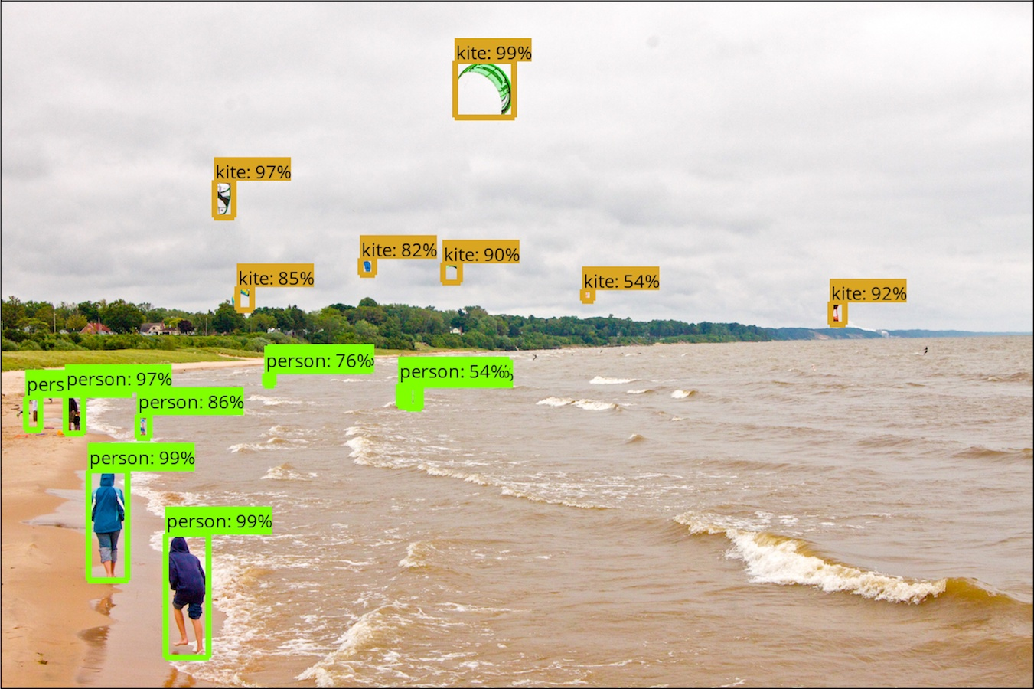
Tensorflow Object Detection API
Open source framework built on top of TensorFlow
Requirements:
Train and test record file
Downloaded Pre-trained model
Trained on Common Objects in Context (COCO) dataset
Model configuration file
The train.py file included is used to then train the object detection file
Example output from the TensorFlow object detection API
Notes:
As I stated on the last slide, the tensorflow object detection api was the tool used to train the lung opacity detector. If tensorflow is already setup to work on the machine you want to train on, cloning the tensorflow github repo will make for an easy. way to train an object detector. The API contains a python file to train, and some utilities to visualize the predictions. Tensorflow additionally provides the pre-built models, and sample configuration files needed to start training the model. After the training is done, the model will. Take in an image and output bounding boxes, and the score for the class. Right out of the box the model is able to output bounding boxes and class scores for the 91 classes that are already in the Common objects in context dataset. The image to the right is an example output.

Slide 17
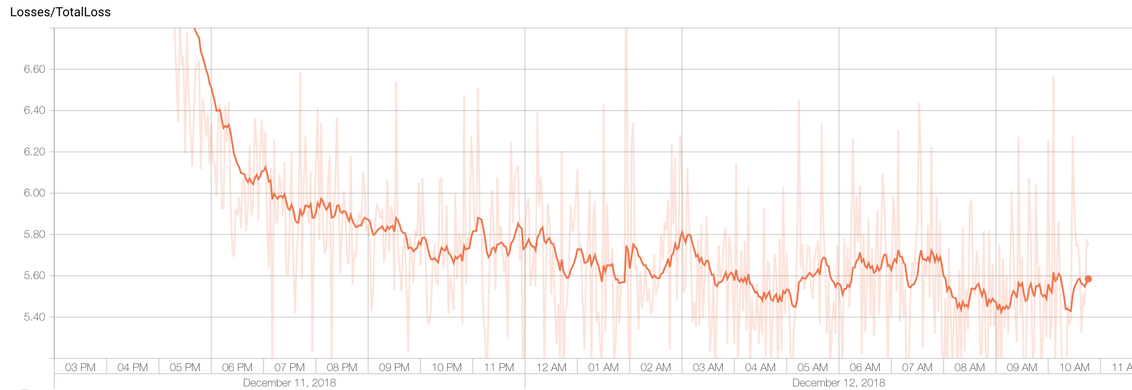
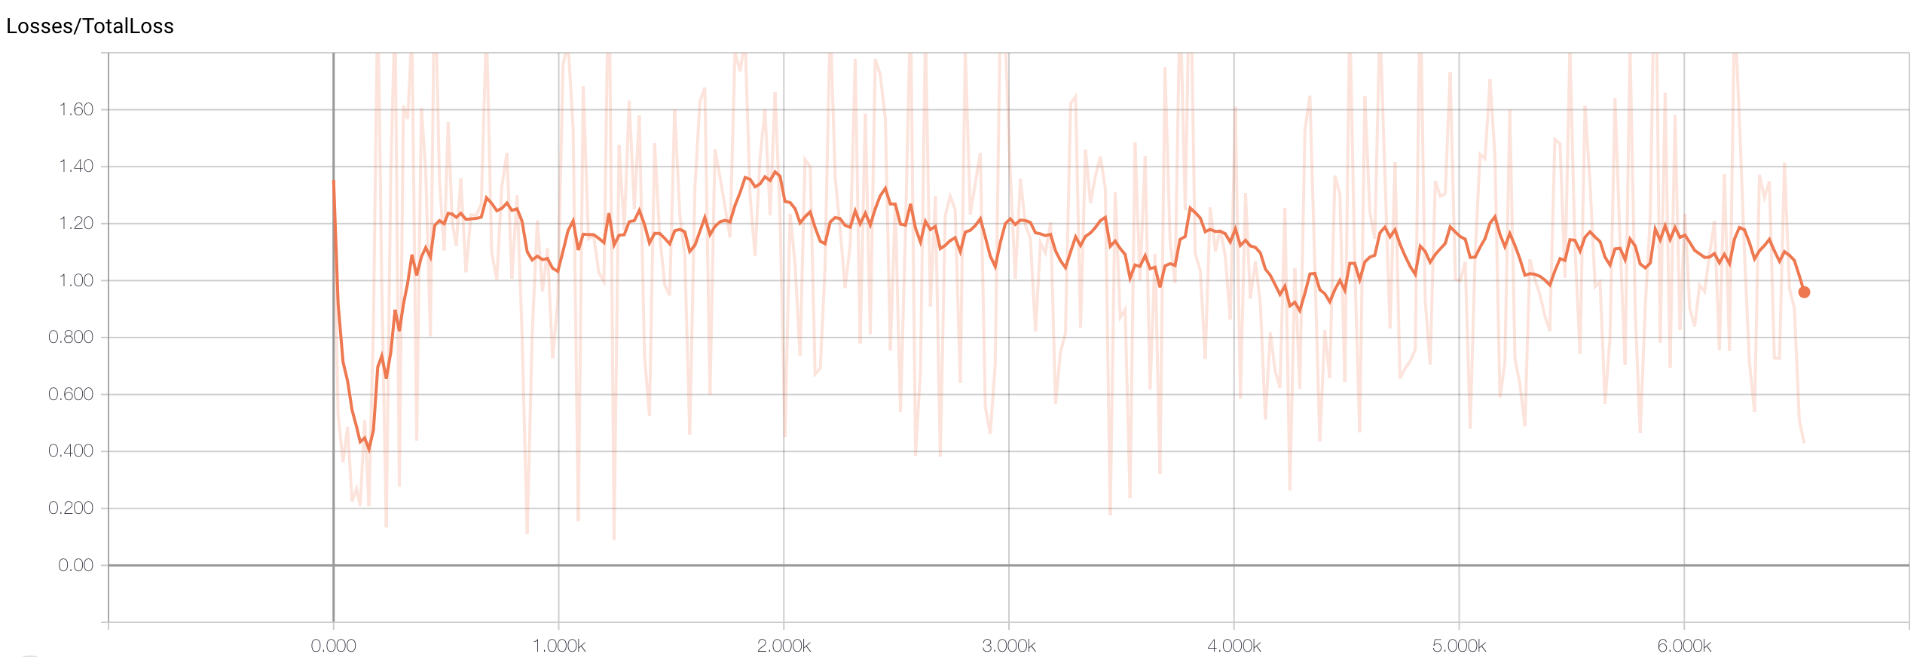
Training the Opacity Detector
SSD MobileNet Nicely Converged around step 8,000
SSD MobileNet was able to train with batch sizes of 24
Trained for 17 hours and 34 minutes
Uses weighted smooth L1 Loss to optimize localization
Faster RCNN ResNet101 could only handle batch sizes of one due to the
Trained for 9 hours and 53 minutes due to non-convergence and time constraints
Utilizes L1 loss for localization
Did not converge as expected
Faster RCNN ResNet101 initially declined, then increased until step 650
Notes:
Back to pneumonia, the first model trained was the Mobilenet SSD model, which was able to train for about 9,000 steps in 17 hours and thirty four minutes. IT was able to take batch sizes of 24, and we provided the total loss learning curve as the top image. As you can see, the mobilenet SSD learning curve took on a shape we would expect for a neural network, somewhat converging around step 8,000
The second model we trained was the faster RCNN model, which trained for about 6,500 steps, or 9 hours and 53 minutes. The learning curve for total loss, as provided on the bottom took an abnormal shape that we were not expecting. Initially the model began converging until around step 100, and then the model began increasing to around the total loss that it started. After the increase in loss, the model steadied relatively quickly. Because of this non-convergence, the Faster RCNN model was stopped earlier than the SSD model.

Slide 18
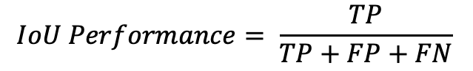
How Did we evaluate the object detector?
Intersection over Union (IoU) was used to determine the performance of the object detector
Area of overlap between a ground truth and a prediction divided by the area of union between a ground truth and prediction
True positive (TP) – IoU of prediction is greater than 0.3
Duplicates of TP objects were ignored
False Positive (FP) – IoU of prediction is less than 0.3
False Negative (FN) – A ground truth that does not have a predicted bounded box greater than 0.3
Area of Overlap
IoU =
Area of Union
$$IoU Performance= \frac{TP}{TP+FP+FN}$$
Notes:
The metrics we used to evaluate the object detector was based off of the concept of intersection over union, or IOU. The illustration to the right shows that IOU is calculated by dividing the area that the predicted box overlaps the ground truth box, by the area of the union made from the ground truth box and the predicted box. We then created a threshold of 0.3 required for a predicted bounded box to be a true positive, or a hit. If the IOU for a predicted box was less than 0.3, then the prediction was determined to be a False Positive. If a ground truth lung opacity box did not have any predicted boxes with an IOU of over 0.3, then the image considered it to be a False Negative. Any duplicates of True Positive predictions were not counted as any metric. After determining the results of each prediction and missed opacity, the model’s performance was calculated to be the number of true positives divided by the sum of true positives, false positives, and false negatives.

Slide 19
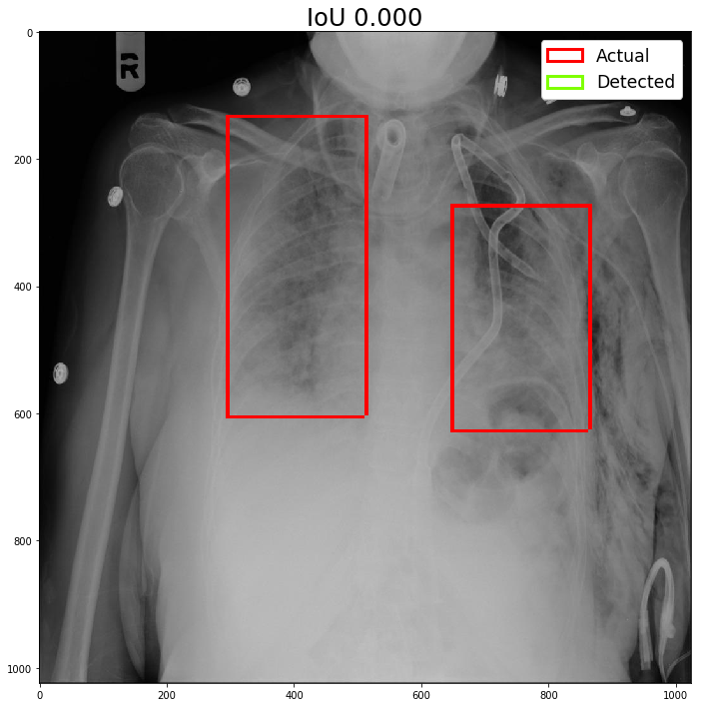
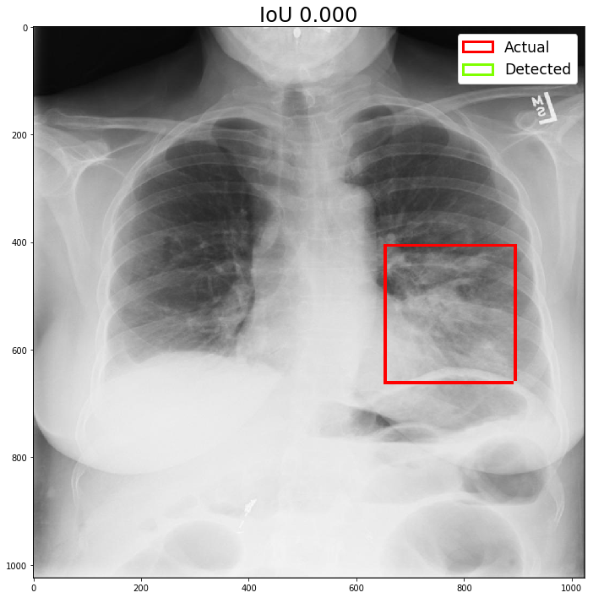
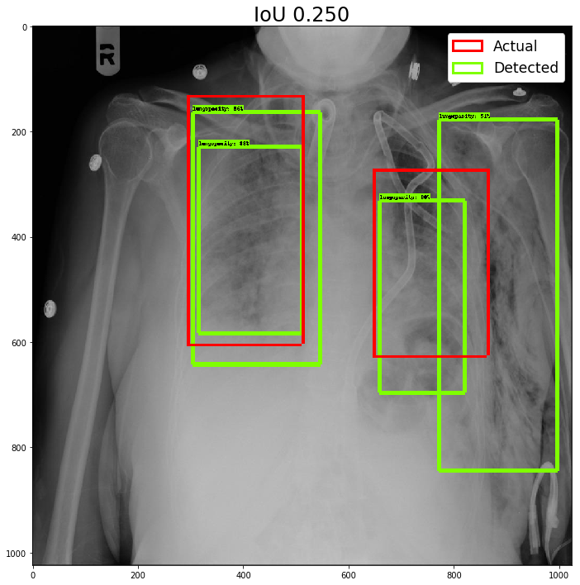
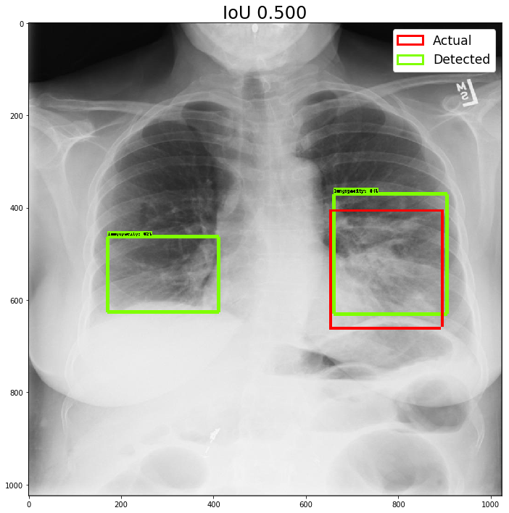
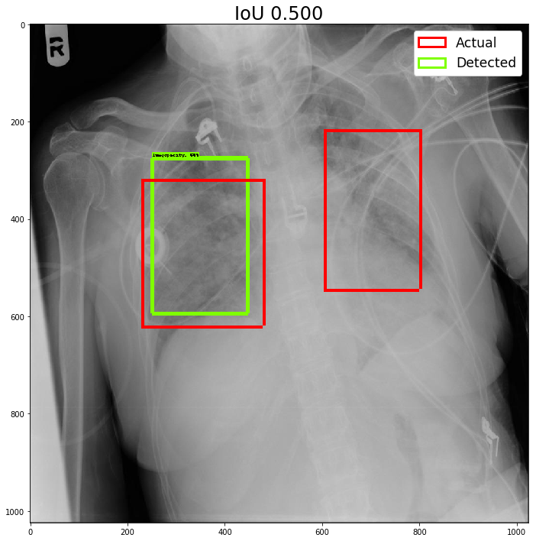
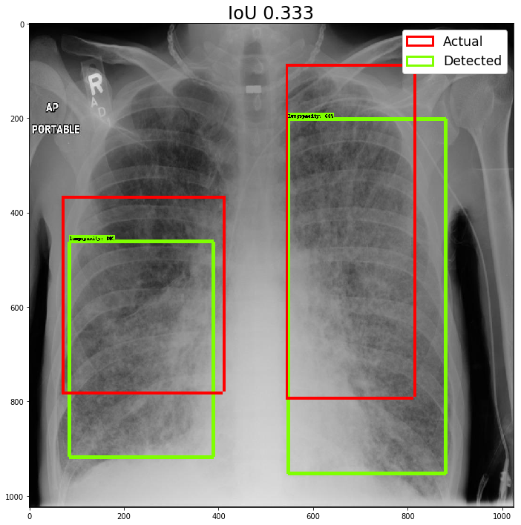
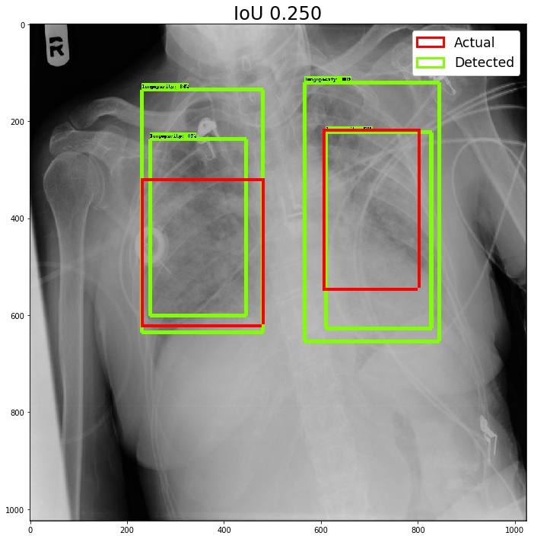
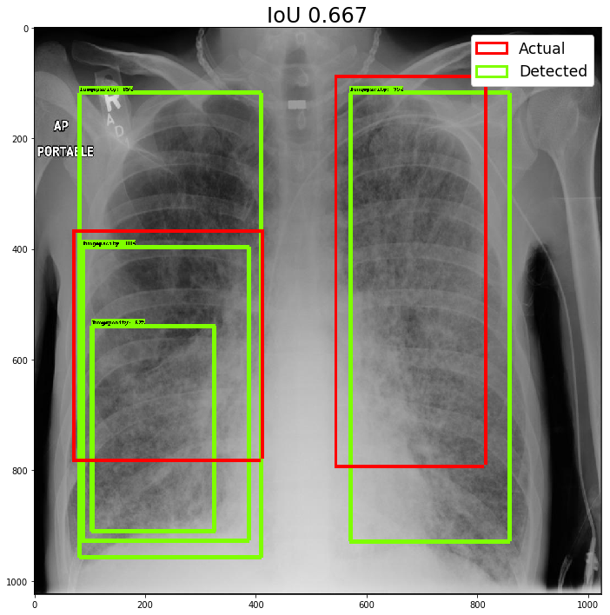
Evaluating the Object Detector
SSD MobileNet Test IoU Performance - 0.2088
Faster RCNN ResNet101 Test IoU Performance - 0.4039
Notes:
After training the images on the training set, and predicting the opacities on the testing images, we were able to calculate the IOU performance of the two models to be about 0.21 for the SSD mobile net model, and 0.40 for the Faster RCNN model. To get an idea of the behavior of the two models, I chose four different images to predict on. As you can see to the right, the SSD mobile net model was stingier with its prediction, performing fairly well when a box is predicted, but missing many.
On the other hand, the Faster RCNN model was much more likely to predict a bounding box, but was prone to have many duplicates and False Positives. This feature of the model likely explains the shape of the total loss curve. In our evaluation of IOU, duplicate predictions on True Positives were ignored, and not penalized; however, the total loss function that the model was trained would penalize when the model predicted more boxes than lung opacities.
While the duplicate predictions of the faster RCNN model is not ideal, we decided that for our purposes the faster rcnn model would be better for lung opacity detection than the MobileNet SSD model because we would rather be more liberal with our bounding boxes when we already expect an opacity to be present. To limit the impact of the duplicate predictions, prediction boxes that have an intersection could be limited to just the smallest bounding box all the boxes that intersect.

Slide 20
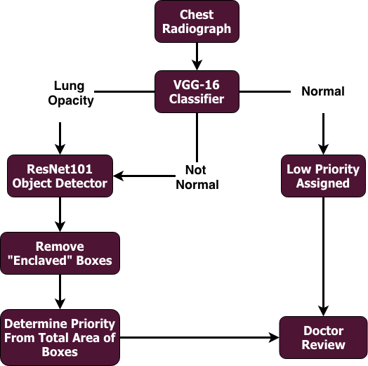
Recommendations to Diagnose Pneumonia
Use both classification and localization to better diagnose pneumonia
Classification could separate the patients that need to pass through object detection model
VGG-16 for classification
Similar performance metrics to VGG-19, but quicker to train and predict
Object detection could assign priority of doctor review based on total area of boxes
Fully surrounded boxes would be removed, or fine-tune training parameters
Resnet101 for localization
Higher performance IoU performance
Low Priority X-Rays
Assigned priority within low priority group
High Priority Images
Age and total area of unique prediction boxes assign priority
Doctor Review
Misclassifications still occur often
Bounding boxes could assist doctor’s efficiency
Not Normal lower priority than lung opacity
Probability of lung opacity as prioritizer
Notes:
So how should we use these fancy models? To most effectively use the classifier and detector, we recommend to implement a system that combines the VGG-16 classifier and the Faster RCNN localizer that prioritizes the order in which doctors review chest radiographs. Because the performance metrics of the models are not good enough to confidently diagnose every chest radiograph, doctors will still need to review each x-ray before a final diagnosis is made. However, creating a pipeline with the two models would be an efficient way to prioritize the order in which doctors review the chest radiographs.
First, the chest radiograph should be passed through the VGG-16 classifier in order to determine whether a x-ray is considered Normal, Not Normal, or Lung Opacity. If an x-ray is considered normal, the patient should be placed in a low priority group within the batch. If an image is considered to contain lung opacities, the patient should be passed through the Faster RCNN Resnet101 object detector, and have the total area of non-duplicate predictions calculated. Using this total area metric, along with patient size and age, a priority score should be assigned and given a high priority status compared to the Normal predicted classes. The x-rays that have been predicted to be not normal should also be passed through the object detector and given a priority score, however in a slightly lower priority than the Lung Opacity patients.

Slide 21
References
https://www.who.int/news-room/fact-sheets/detail/pneumonia
https://www.cdc.gov/nchs/fastats/pneumonia.htm
https://www.nhlbi.nih.gov/health-topics/pneumonia
Goodman, L. R. (2014). Felsons principles of chest roentgenology: A programmed text. Philadelphia: Saunders.
Notes:
And that’s it! I hope you enjoyed the presentation, and I hope you never have to see another chest x-ray ever again!

